Slide 1
Instructions:
You may change these slides as you see fit. You may add or remove slides. You do not need to use this slide at all.
Notes:
Please tell us about the challenges you may have faced, what you would have done differently and how you would have solved these problems if you had more time.
Mention all design considerations and talk about why you chose to implement certain advanced features.

Slide 2

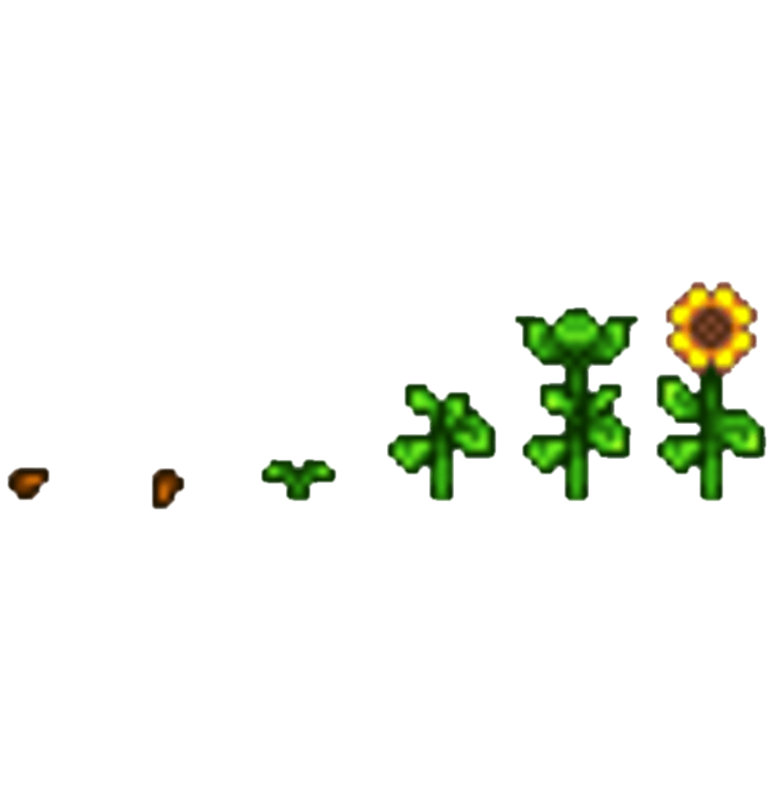
Stardew Valley
THE STRUGGLES OF SOLO DEVELOPERS
Yatai Tian
yataitian@gmail.com
Notes:
WELCOME

Slide 3




Interests and Hobbies
Stardew Valley (Farming + more!)
Teamfight Tactics (Auto Battler)
Valorant (First Person Shooter)
Data Visualization
Creating Future Technology
Notes:
This section is NOT assessed. We just want to get to know you ☺. (ya sure about that)

Slide 4

Data Science
The search for greatness

Slide 5

Best part of MSA
Learning!
Juypter Notebook
API calling
Mid-sem work

Slide 6

What MSA can improve on?
Tutorial on setting up Virtual Machine and the benefits
Thoroughly enjoyed it all

Slide 7



Future Goals
Actively learning
Become more comfortable in R, Python and SQL
Playing with class and packages for Data Science
Create more projects along the way
Notes:
Data visualization and communication, multivariable calculus and linear algebra, programming skills, stats, machine learning

Slide 8




Motivation
Solo developers
Update their game (free)
Find bugs
Build something else
Eric Barone
Notes:
Games are cool

Slide 9
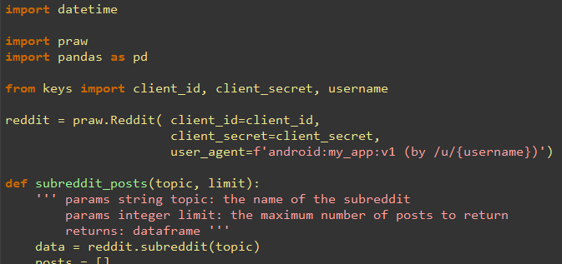
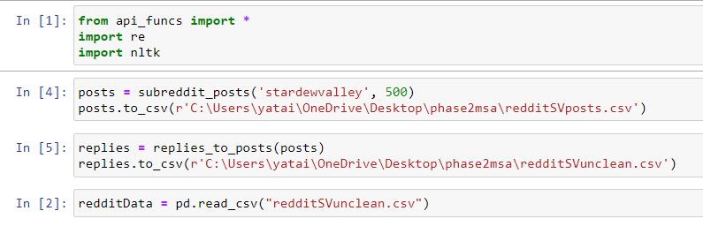
Data Extracting
API calling using prebuilt package
Notes:
Talk about your database, what schema you used and what data you used

Slide 10
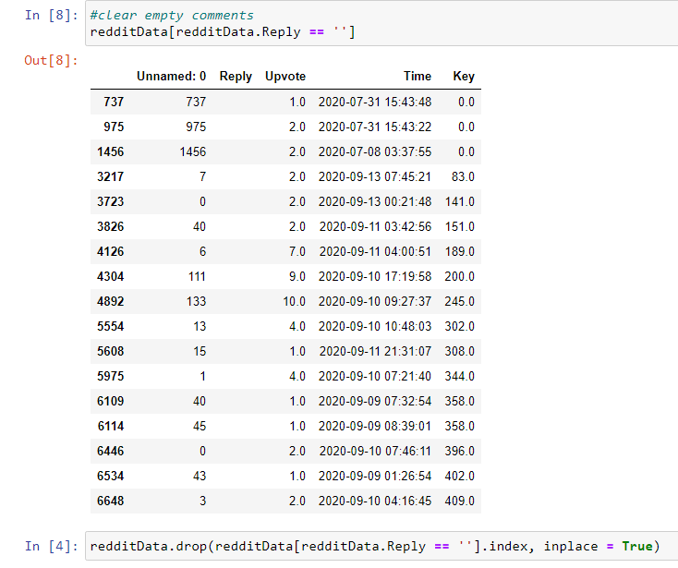
Data Cleaning
Removing links
Removing tagging users, bots and subreddits (u/, U/, r/, R/)
Removing empty replies

Slide 11
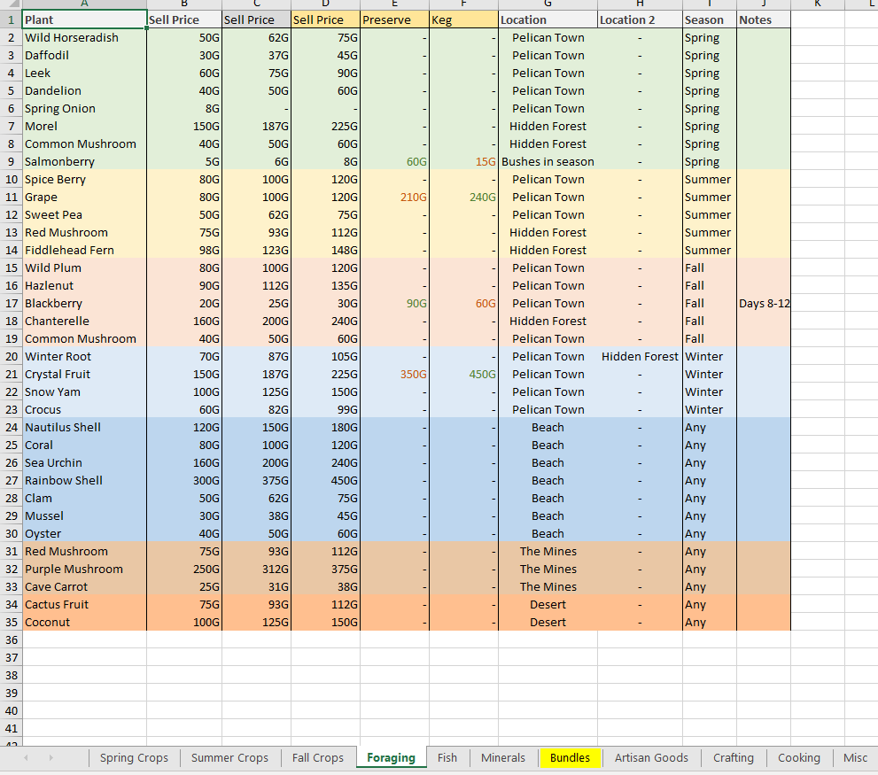
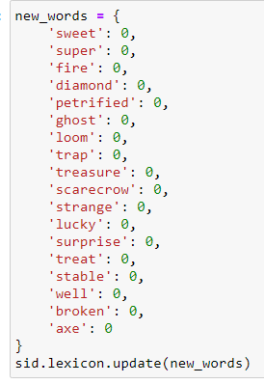
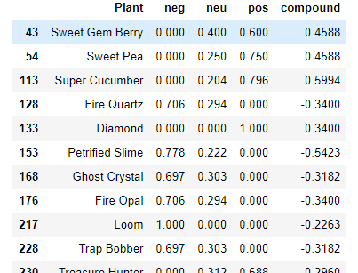
Data Cleaning
Check commonly used terms in Stardew Valley
Notes:
EXTRACTED EXCEL FROM REDDIT, OUTPUT TO CSV AFTER THIS STEP AND INTO R

Slide 12
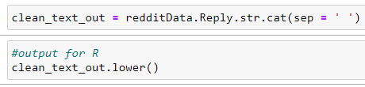
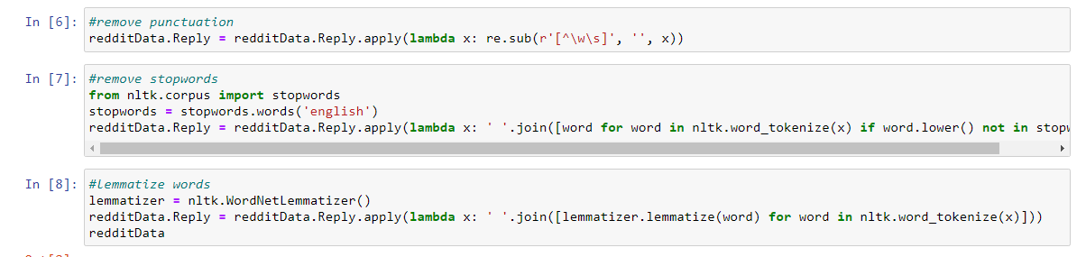
Data Cleaning
Remove punctuation
Remove stop words
Lemmatize words

Slide 13
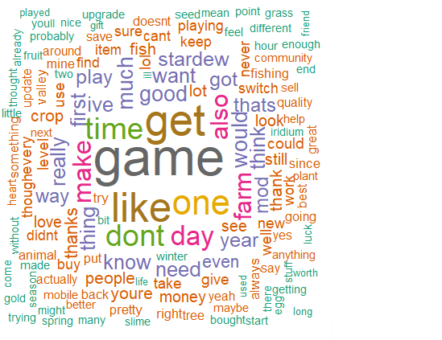
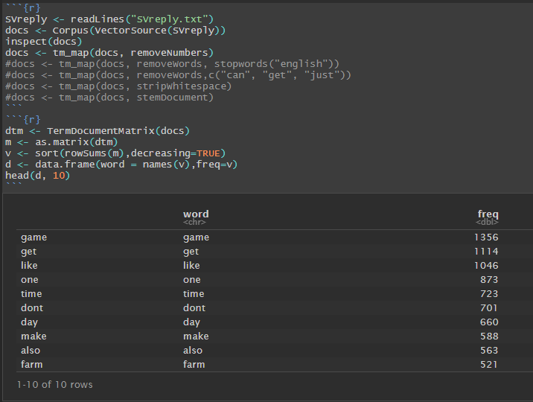
Data Exploration
Finding most common words in replies

Slide 14
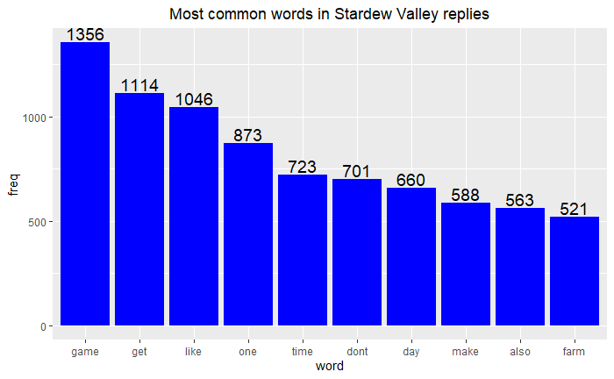
Data Exploration
500 Posts

Slide 15
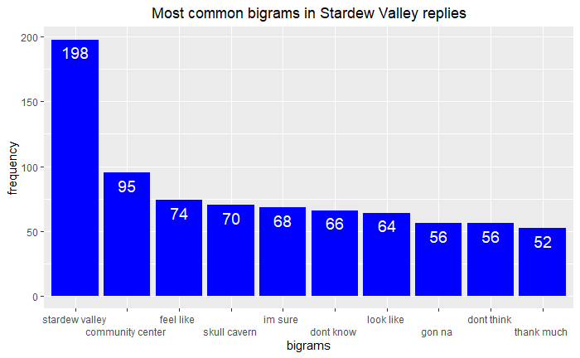
Data Exploration

Slide 16
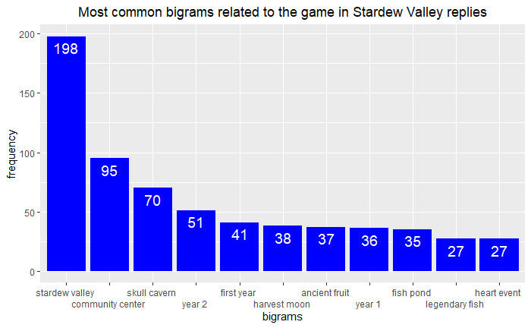
Data Exploration

Slide 17
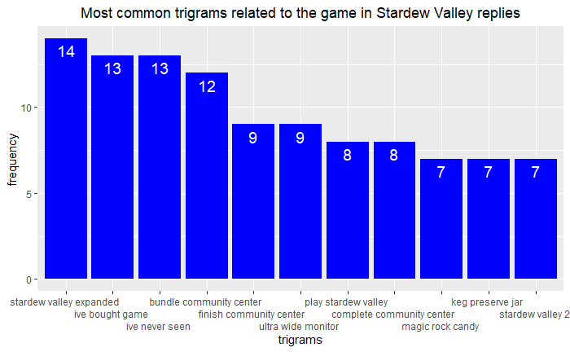
Data Exploration

Slide 18
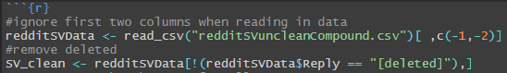
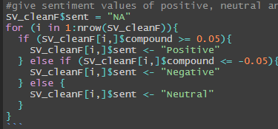
Sentiment Analysis
Last minute clean with deleted comments
Used common values in vader Github to subset compound data
Notes:
Explain your Azure features here

Slide 19
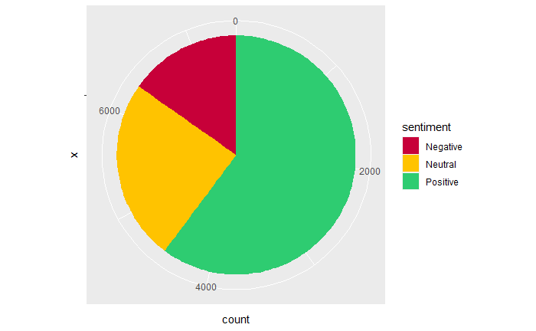
Sentiment Analysis
15.3%
24.5%
60.2%
Notes:
Explain your Azure features here

Slide 20
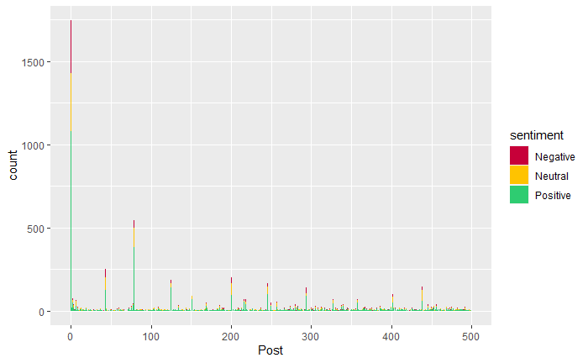
Sentiment Analysis
Notes:
First post was FAQ so lots of comments

Slide 21
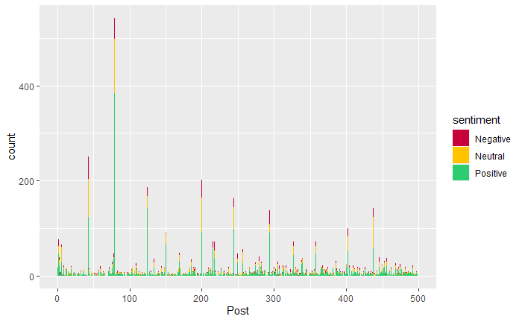
Sentiment Analysis
Notes:
Removed first post

Slide 22
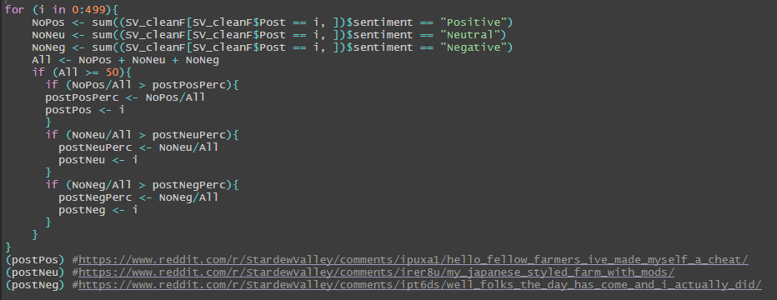
Sentiment Analysis
Notes:
Note the 50

Slide 23
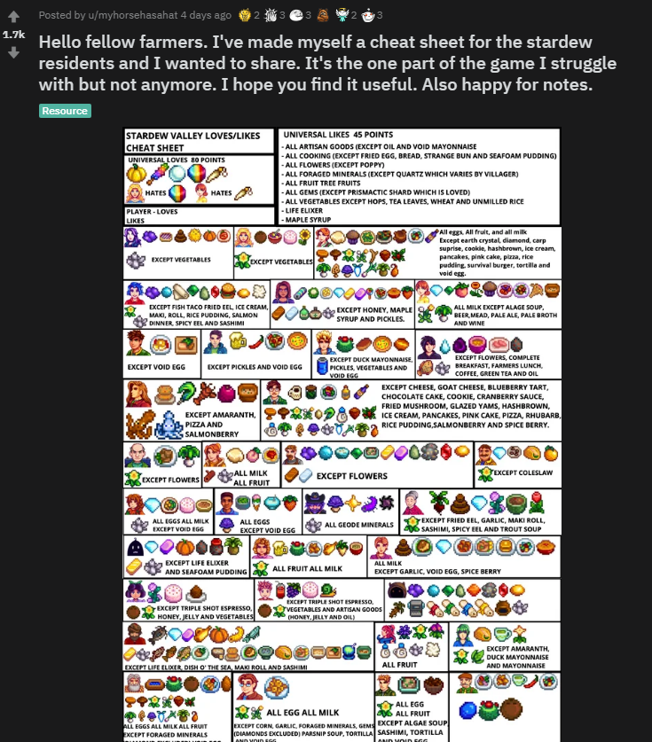
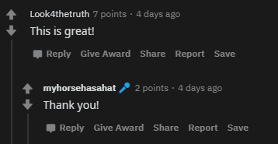
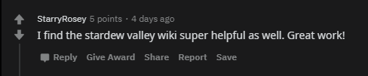
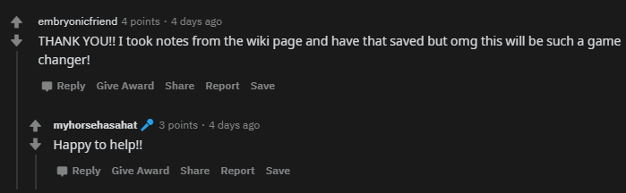
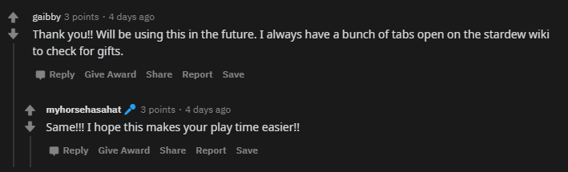
Sentiment Analysis
Most Positive Post Replies (79% pos)

Slide 24
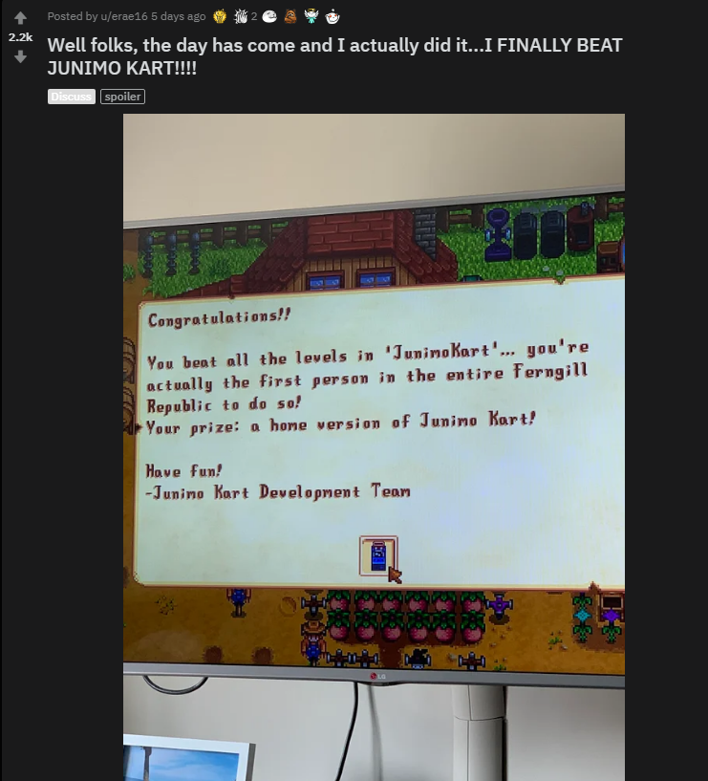
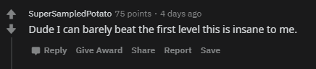
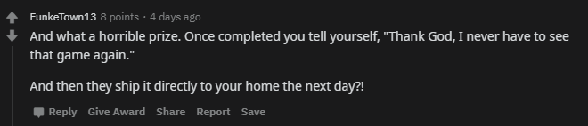
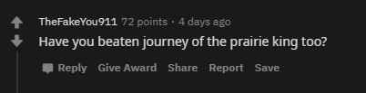
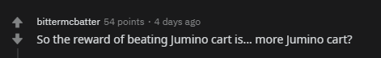
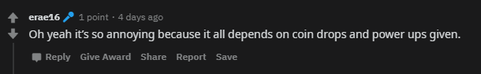
Sentiment Analysis
Most Negative Post Replies (25% neg)
Notes:
Note the 50

Slide 25
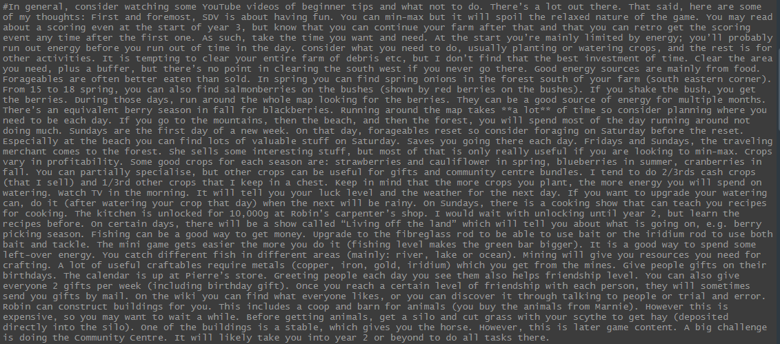
Sentiment Analysis
Highest compound score (0.9987)
“SDV is about having fun”
“Relaxed nature of the game”
“Good energy sources are mainly from food”
“Crops vary in profitably”
“Good crops”
“Fishing can we a good way to get money”
“Find what everyone likes”
“It is a good way…”
Notes:
Negative because talking about beating a game, "beaten" is a negative word but in this context it refers to passing a game. Compound score for "beaten" only is -0.4215. Examples of this in comments is "Have you beaten journey of the prairie king too?", "Dude I can barely beat the first level this is insane to me" and "I have only gotten to the mushroom level. I have beaten the prairie king though". Furthermore, using words that could mean different things in different context such as "You're actually insane" scored -0.4019 although it was a compliment. Funnily enough ":o" scores a negative sentiment score too.

Slide 26
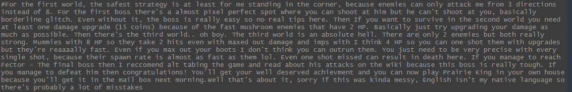
Sentiment Analysis
Lowest compound score (-0.9864)
“Because enemies can only attack me from…”
“Where you can shoot at him but he can’t shoot at you”
“At least one damage upgrade”
“Is an absolute hell”
“only 2 enemies”
“2 hits even with maxed out damage”
“missed can result in death here”
Notes:
Note the 50

Slide 27

Data/Sentimental Analysis
NEXT STEPS
Too many game related terms for sentimental analysis
Have a different subreddit for game suggestion changes
Alert the developer when the post gets a certain number of upvotes
Taking the top number of posts per week
Notes:
Take the top 10 + any leftover over 500 upvotes etc

Slide 28
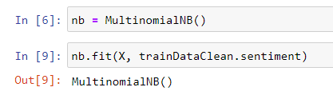
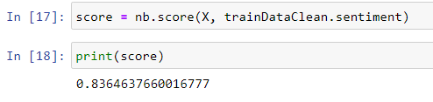
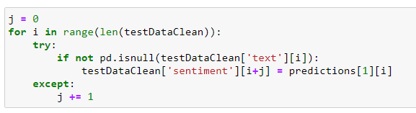

Kaggle Challenge
Tutorial was great
Exposure to Python packages
Notes:
Advanced features… challenges is spent a day getting the predictions to line up with the data.

Slide 29
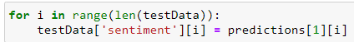
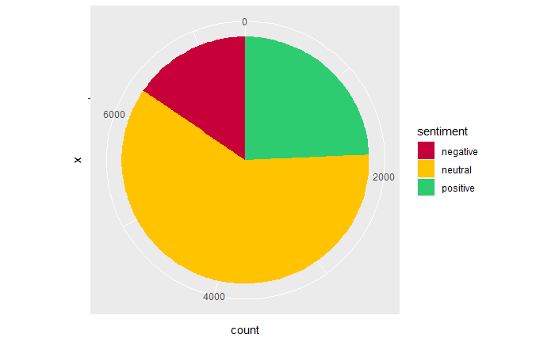
Advanced Requirements
1)
2)
Notes:
Advanced considerations…

Slide 30
Sentiment Analysis
VADER VS OWN MODEL
15.3%
15.5%
24.3%
24.5%
60.2%
60.2%
Notes:
seems to be less words to train so there is more neutral

Slide 31

Final Comments
Thank you for listening
Notes:
Any final things you want to tell us

